Slide 1
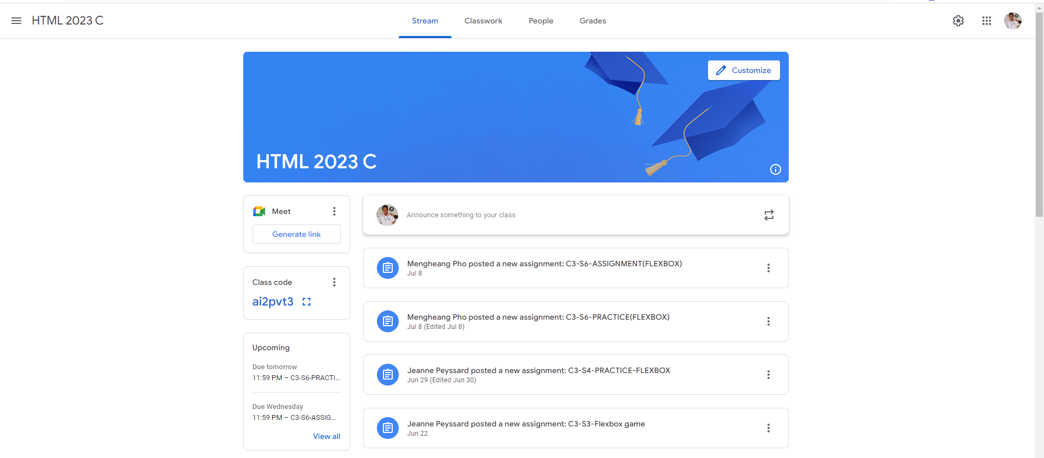
Identify root components of website below

Slide 2
Flex: 0,
Nav
Container
Flex: 1,

Slide 3
Nav-left
Nav-center
Nav-right

Slide 4
icon
text
text
text
text
text
icon
icon
icon

Slide 5
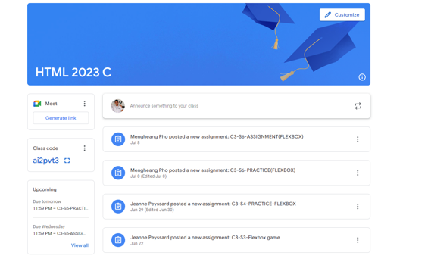
Header
Asidebar

Slide 6

Button
Text
Icon

Slide 7
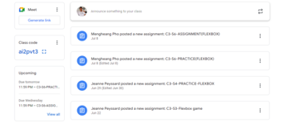
box
card
card
card
card
box
card
card
box
card
card
card
card

Slide 8

Icon
Icon
Icon
text
Icon
button

